Slide 1
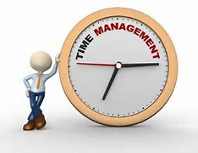
TIME MANAGEMENT
DEVANGINI V. KATHAD
160410116049
SY IT-1

Slide 2

WHAT IS TIME MANAGEMENT?
Time Management refers to managing time effectively so that the right time is allocated to the right activity.
Effective time management allows individuals to assign specific time slots to activities as per their importance.
Time Management refers to making the best use of time as time is always limited.

Slide 3

WHY DO WE NEED TM?
To save time.
To reduce stress.
To increase our output.
To have more control over job responsibilities.

Slide 4
HOW TO US TIME EFFECTIVELY
Effective planning.
Setting goals and objectives.
Setting deadlines.
Delegation of responsibilities.
Prioritizing activities as per their importance.
Spending the right time on the right activity.

Slide 5
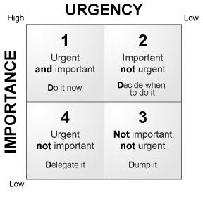

Slide 6
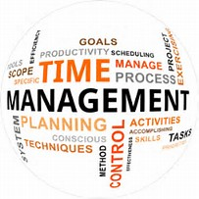
TIME MANAGEMENT PROCESS
Cost your time.
Making activity logs.
Goal setting.
Planning.
Prioritizing.
Scheduling.

Slide 7

COSTING YOUR TIME
Understand the true value by calculating your cost per year.
Cost per year=(salary + taxes + office space + office equipment + profit your generate)

Slide 8

MAKING ACTIVITY LOGS
Make a realistic estimate of time spend during day on job orders.
Pinpoint the critical areas.
Finding the high yielding time of our day.

Slide 9


GOAL SETTING
Setting lifetime goals help to chart your life course and career path.
Breakup your lifetime goal in smaller goals.
Make a daily To-Do list.
Revise and update your list on daily basis and judge your performance.

Slide 10
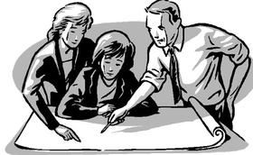
PLANNING
Draw an action plan – A list of things that need to be done to achieve your goals.

Slide 11

PRIORITIZING
Make a To-Do list.
Consider the value of task before doing it. Is it worth spending your time.
Prioritize your task-
The most important work should be completed first followed by the other works.

Slide 12

SCHEDULING
Make a realistic estimate of how much you can do.
Plan to make the best use of the available time.
Reserve some time to deal with “ unexpected work”.
Minimize stress by avoiding commitment by yourself and others.

Slide 13

ACHIEVE YOUR GOALS
Be your own judge and your own motivator.
Make TIME MANAGEMENT your tool for success.

Slide 14
CASE STUDY
In real life everybody has to manage time otherwise he/she will be in great loss.
Whether he/she is actor, businessman, employee, student, prime minister, etc. they all have to manage their time in effective way.
Best example for this is our prime minister Narendra Modi. He manages his time in best way. He work for 18 hours but he manages to get time for his personal life as well for his job. If he doesn’t manages his time properly he will be in loss, our nation will be in loss.
Even students need to manage their time effective otherwise they might get loss in their study. They have to make schedule for managing time. If a student is sports man then he can not only give his entire time to sport only. He have to manage time for both his sport as well for his education, which will give him a best outcome.

Slide 15


